Slide 1
DevOps
03 - Bash
Павел Боев 02.2021

Slide 2
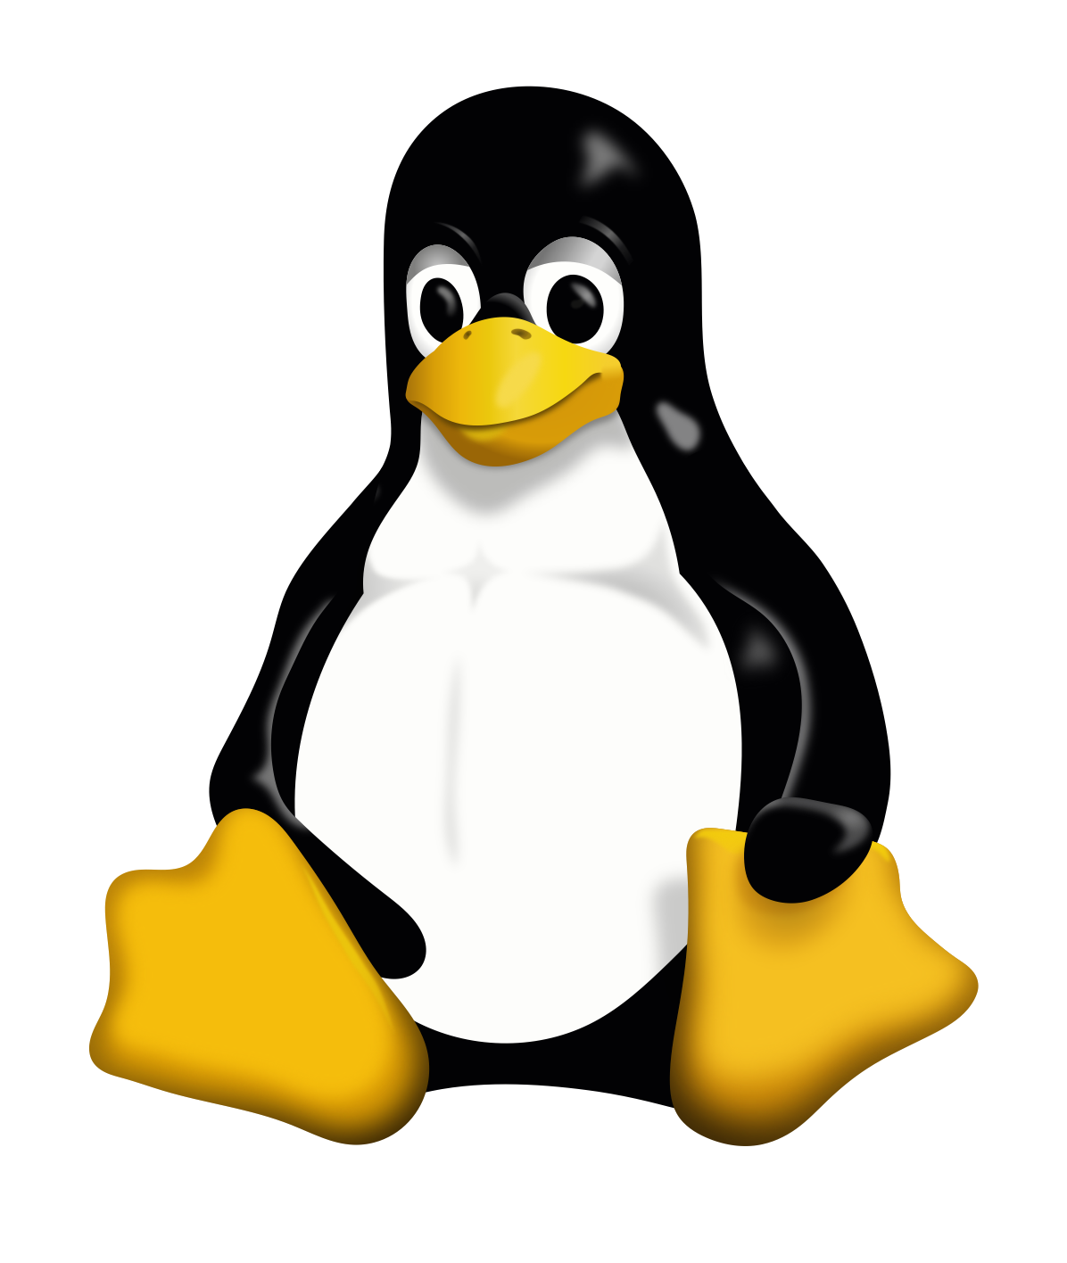
What is Linux
The most widely used operating system for servers, guaranteed!
Probably the most widely used OS overall, if you count Android phones, smart appliances, all docker containers, etc.
Based on Unix
Open source
Linux kernel was developed by Linus Torvalds (the guy who later developed Git)

Slide 3
Core concepts
Bootloader – The software that manages the boot process of your computer.
Kernel – The lowest level of the OS. It is the core of the system and manages the CPU, memory, and peripheral devices.
Init system – This is a sub-system that bootstraps the user space and is charged with controlling daemons.
Daemons – These are background services (printing, sound, scheduling, etc.) that either start up during boot or after you log into the desktop.
Graphical server – This is the sub-system that displays the graphics on your monitor. It is commonly referred to as the X server or just X.
Desktop environment – This is the piece that the users actually interact with. There are many desktop environments to choose from (GNOME, Cinnamon, Mate, Pantheon, Enlightenment, KDE, Xfce, etc.).
Applications – Programs that you actually do work with. With package managers, such as apt (on Ubuntu) or yum (on RHEL-like distributions) it is easy to install and find new applications
https://www.linux.com/what-is-linux
Notes:
Boot loader - For most users, this will simply be a splash screen that pops up and eventually goes away to boot into the operating system.
Init system - One of the most widely used init systems is systemd? which also happens to be one of the most controversial. It is the init system that manages the boot process, once the initial booting is handed over from the bootloader (i.e., GRUB or GRand Unified Bootloader).
Graphical server - Each desktop environment includes built-in applications (such as file managers, configuration tools, web browsers, and games). We won’t use graphical server a lot in the DevOps world

Slide 4
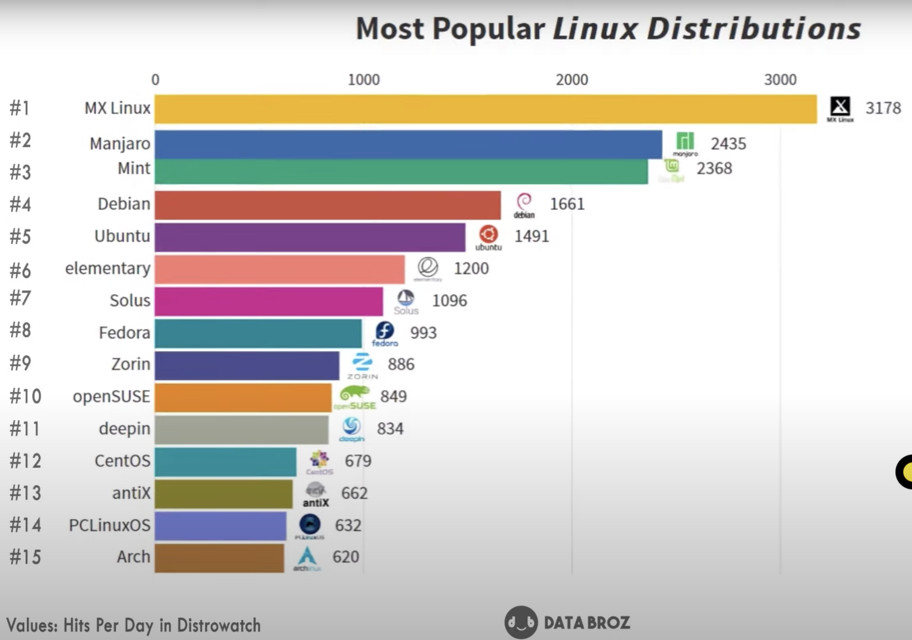
Distributions
A Linux distribution (distro) is OS, comprised of Linux kernel + collection of pre-installed software, such as:
package manager – tool for obtaining new software and updating the system
GNU tools and libraries
additional software (e.g python, text editors, etc.)
documentation
(optional) window system
(optional) window manager
(optional) desktop environment (such as GNOME, KDE, etc.)
There are more than 1000 distros and you can easily make your own
https://youtu.be/YMCylaT4iV4

Slide 5
User, Groups, Permissions
Basic permissions – read /r/, write /w/, execute /x/
Applied to user, group, other
Special modes:
setuid (use cautiously) – executable can be executed with privileges of file owner
setgid - binary executable can be executed with privileges of file’s group
sticky bit – commonly used on directories to limit the ability to move or delete objects in the directory to object owner, directory owner, super-user
Commonly expressed in octal notation (such as 755, 600, 777)
http://permissions-calculator.org/

Slide 6
What is a shell?
A shell is a way to interact with the Linux OS
login shell: A login shell logs you into the system as a specific user
non-login shell: A shell that is executed without logging in. There must be a current logged in user
interactive shell: A shell (login or non-login) where you can interactively type or interrupt commands.
non-interactive shell: A (sub)shell that is probably run from an automated process you will see neither input nor output when the calling process don't handle it
Bourne shell
Bourne shell (sh)
Korn shell (ksh)
Bourne again shell (bash)
POSIX shell (sh)
C-type shells (csh, tcsh)

Slide 7
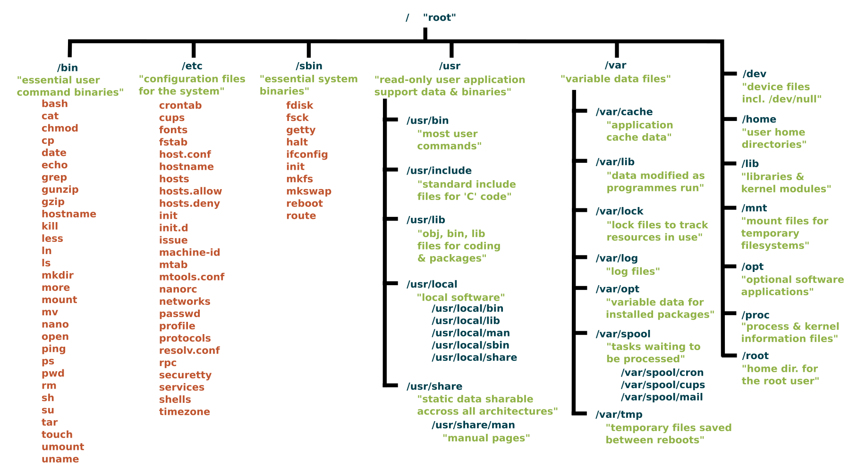
The Linux File System
https://www.linux.com/training-tutorials/linux-filesystem-explained/

Slide 8
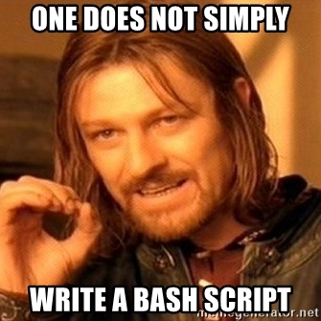
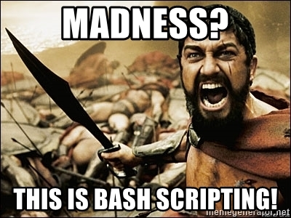
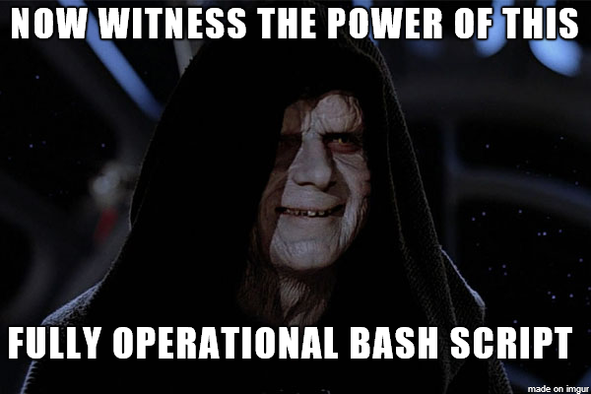
Let’s do some Bash scripting
Notes:
Array
arr=(1 2 3 4 5 6)
Be careful with space
var1=3 - OK
var2 = 3 – not OK
declare –r – read-only
$0 – the script itself
$1, $2, … arguments
$@ - all arguments
$# - number of arguments

Slide 9
Real-life scripts
catalina.sh
https://github.com/Axway/ats-agent-docker/blob/master/docker_files/entrypoint.sh

